Slide 1





December 2023
UNITED STATES 2021 NATALITY ANALYSIS
Examining birth related healthcare outcomes in privatized medicine
Presented By: Anthony Banda, Daniel Kenet, Emily Sims, and Jarret Baum

Slide 2

t
Agenda
01
Introduction:
Research Statement & Hypothesis
02
Data:
Origin & Cleanup Process
03
Data Analysis
04
Conclusion
05
Q&A

Slide 3





Research
Statement
Hypothesis
The goal of our project is to examine US birth rate data for patterns in healthcare outcomes based on payment sources at delivery.
There is a positive correlation between birth rate data and payment sources at delivery in regards to various healthcare outcomes.

Slide 4



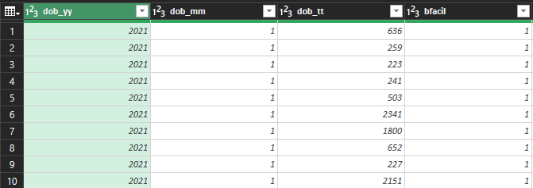
Data Origin:
Where did it come from and what form?

Slide 5
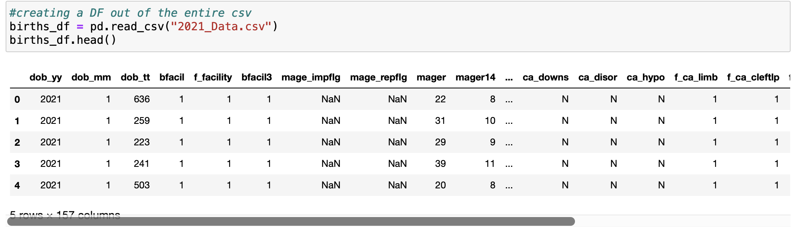
Clean Up Process:
BEFORE

Slide 6
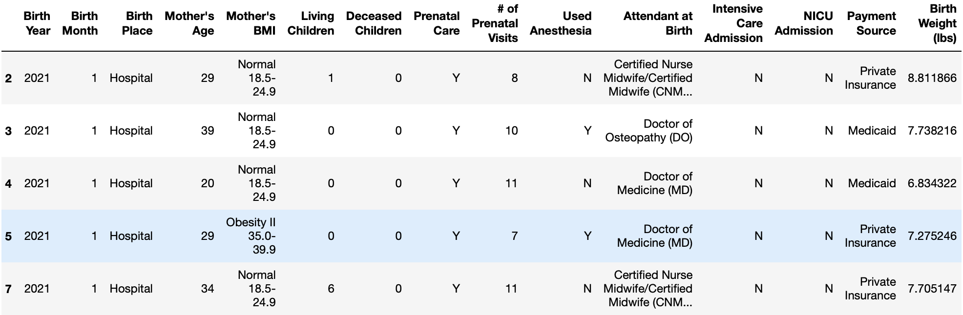
Clean Up Process:
AFTER

Slide 7

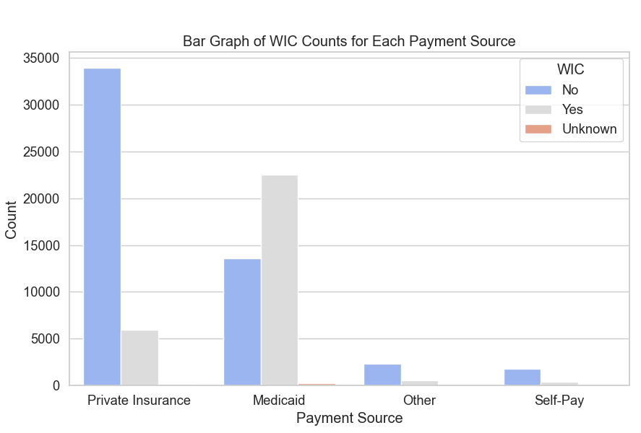
Data Point 1: WIC Utilization and Payment Source
The correlation coefficient is approximately -0.47, indicating a moderate negative correlation between 'Payment Source' and 'WIC'.
This suggests that as one variable increases, the other tends to decrease.
The p-value is very close to zero (0.0), which means that the observed correlation is statistically significant.
Notes:
With a p-value of zero, it's highly unlikely that this correlation occurred by random chance. While, these correlations can provide insights into the relationships between different variables and the payment source please keep in mind that correlation does not imply causation, and further analysis is needed to understand the underlying factors influencing these relationships such as Socioeconomic Status, Education Level, Geographic Location, Cultural and Ethnic Considerations, Health Behaviors (smoking, alcohol consumption, diet), etc.

Slide 8
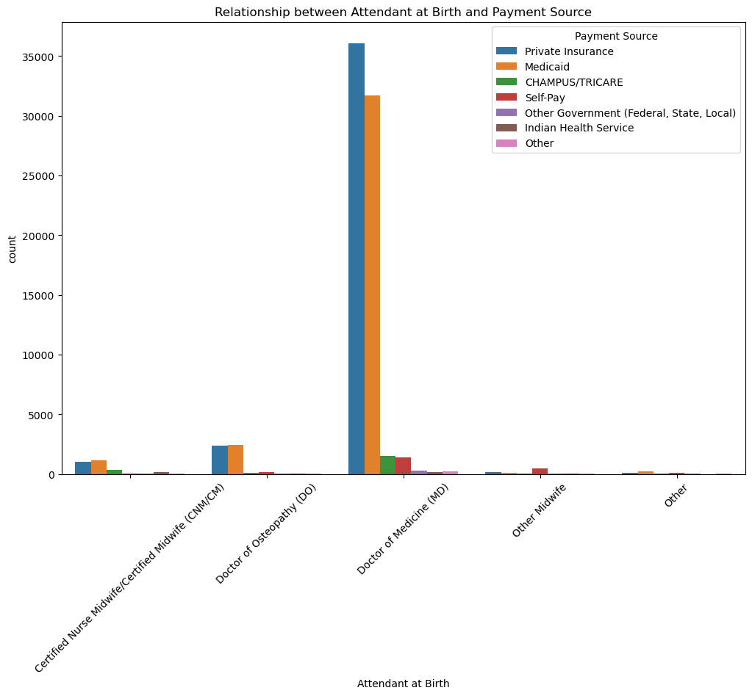
Data Point 2: Attending Physician at Birth vs Payment Source
Mothers using private insurance are more likely to have a Doctor of Medicine as their attending physician than those with Medicaid.
A p-value of 0.0, tells us that the attending physician is strongly correlated to the payment type.

Slide 9
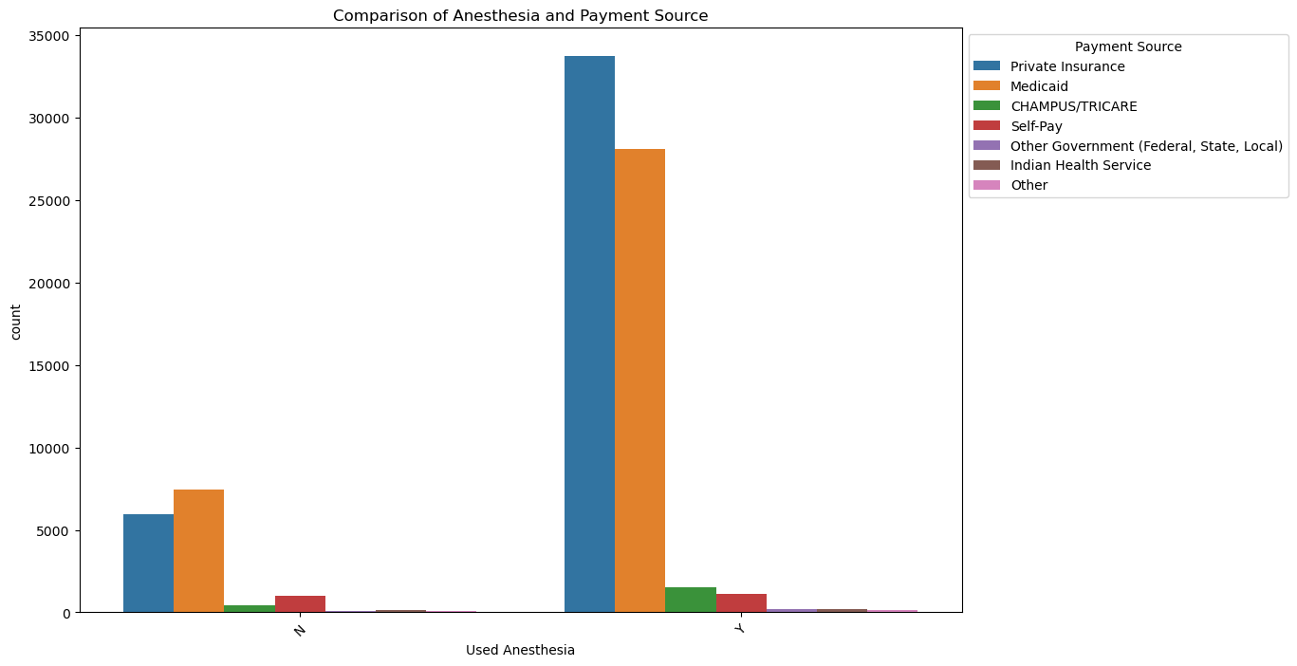
Data Point 3: Anesthesia vs Payment Source
Based on the p-value of 0.0, we can infer that Mothers with private insurance are far more likely to use Anesthesia than mothers with Medicaid.

Slide 10
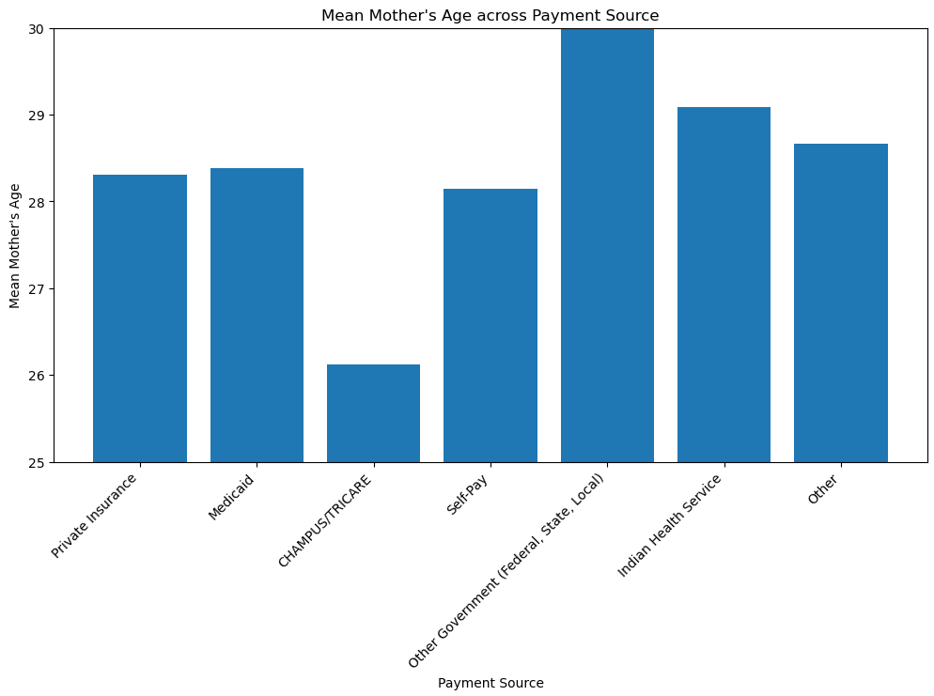
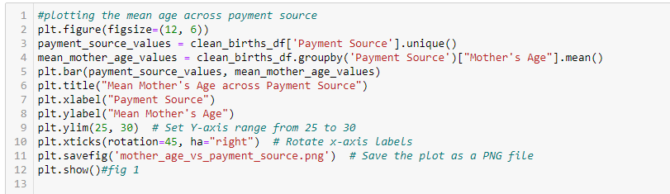
Data Point 4: Mother’s age versus payment source
Military personnel insurance
Similar numbers otherwise
Standard deviation of 5.66

Slide 11
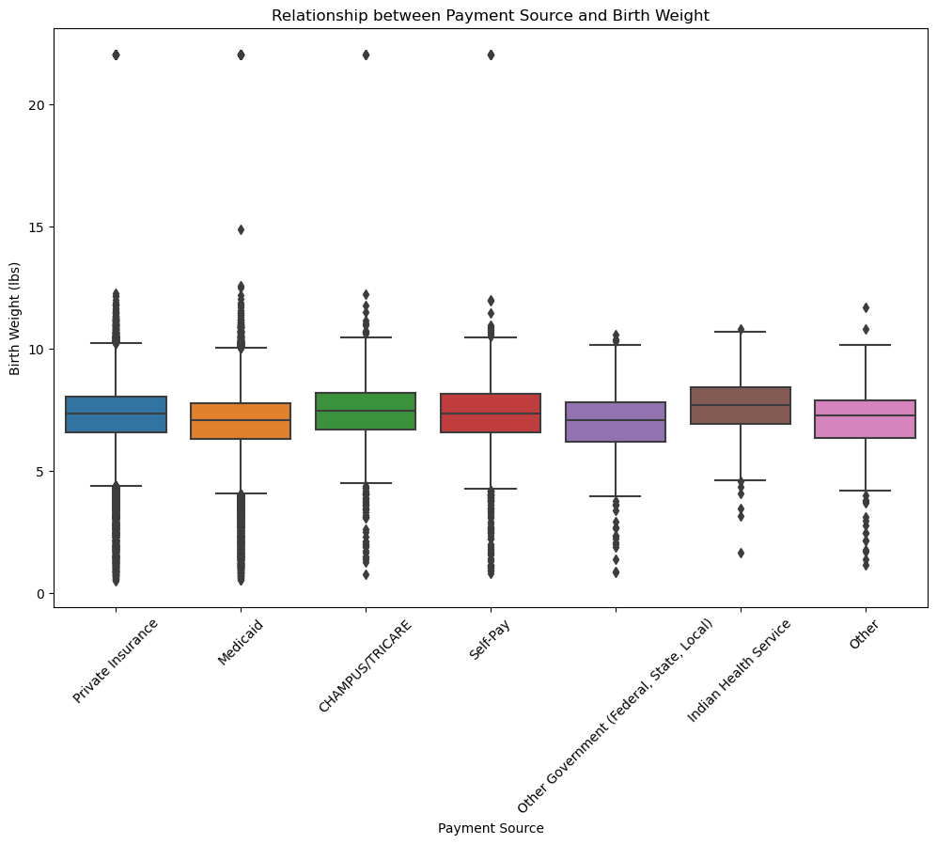
Data Point 5: Birth Weight vs Payment Source
The majority of birth weights are between 4 and 10 pounds.
The Private insurance birth group has a slightly higher average weight than the Medicaid group.

Slide 12
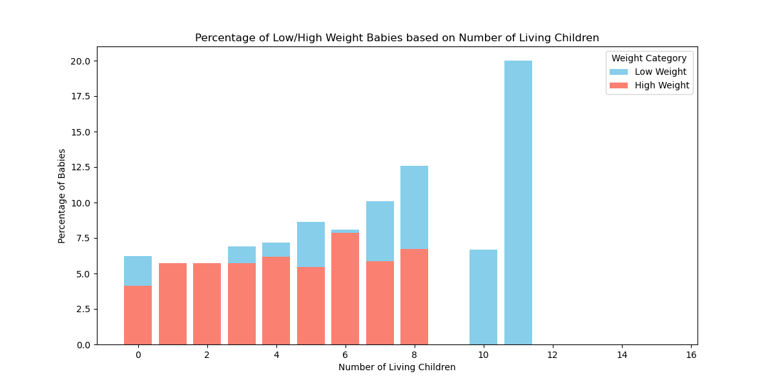
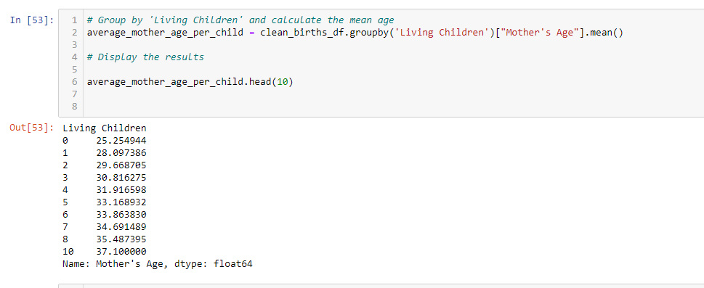
Data Point 6: previous children versus risks of low/higher weight
With age, the risks become more prevalent, and first pregnancies tend to have more complications than following ones (age pending)

Slide 13
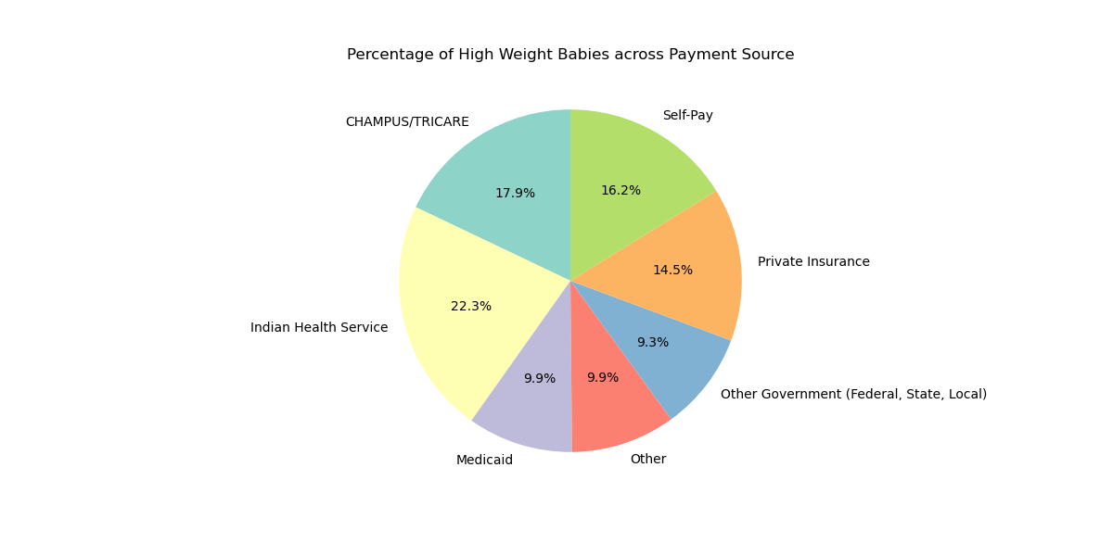
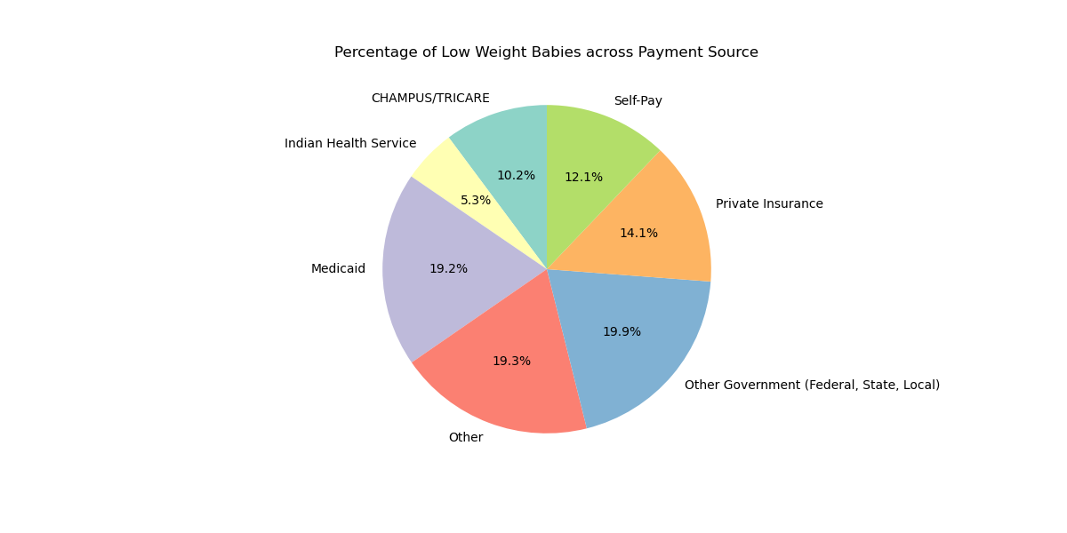
Data Point 6: low weight and high weight babies versus payment source
WHO: “The average weight of a baby born at 37–40 weeks ranges from 5 lb 8 oz to 8 lb 13 oz.”
Government sided distribution for lower weight
No access to healthy foods with higher weight

Slide 14
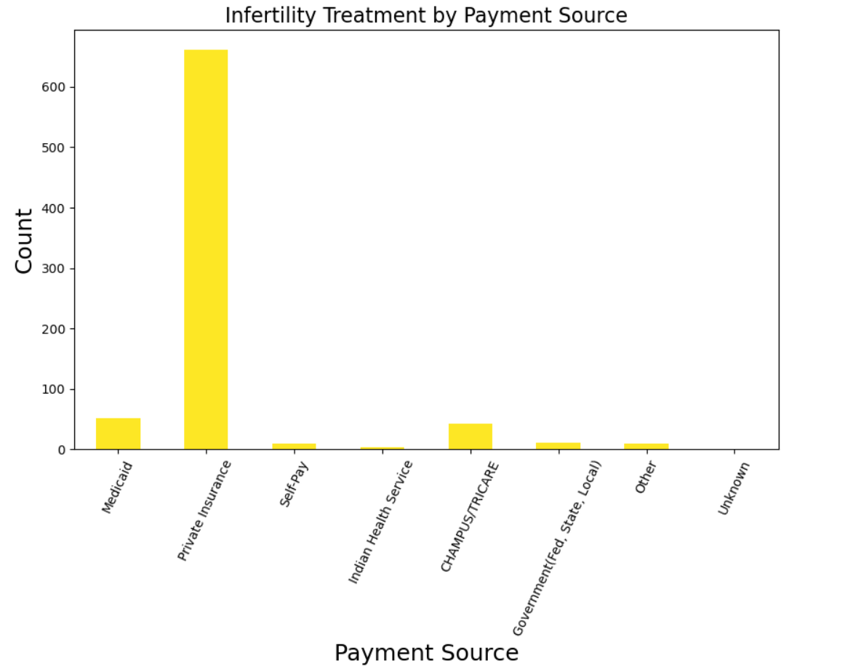
Data Point 7: Infertility Treatment and Payment Methods used
What is Infertility?
Infertility is the inability to conceive after a year of unprotected intercourse. Medical conditions, age, and reproductive challenges contribute to this difficulty in conception.
Examining The Data:
Emphasis on financial avenues for infertility assistance.
Prominent reliance on 'Private Insurance,' revealing its substantial role in supporting individuals on their paths to parenthood.

Slide 15
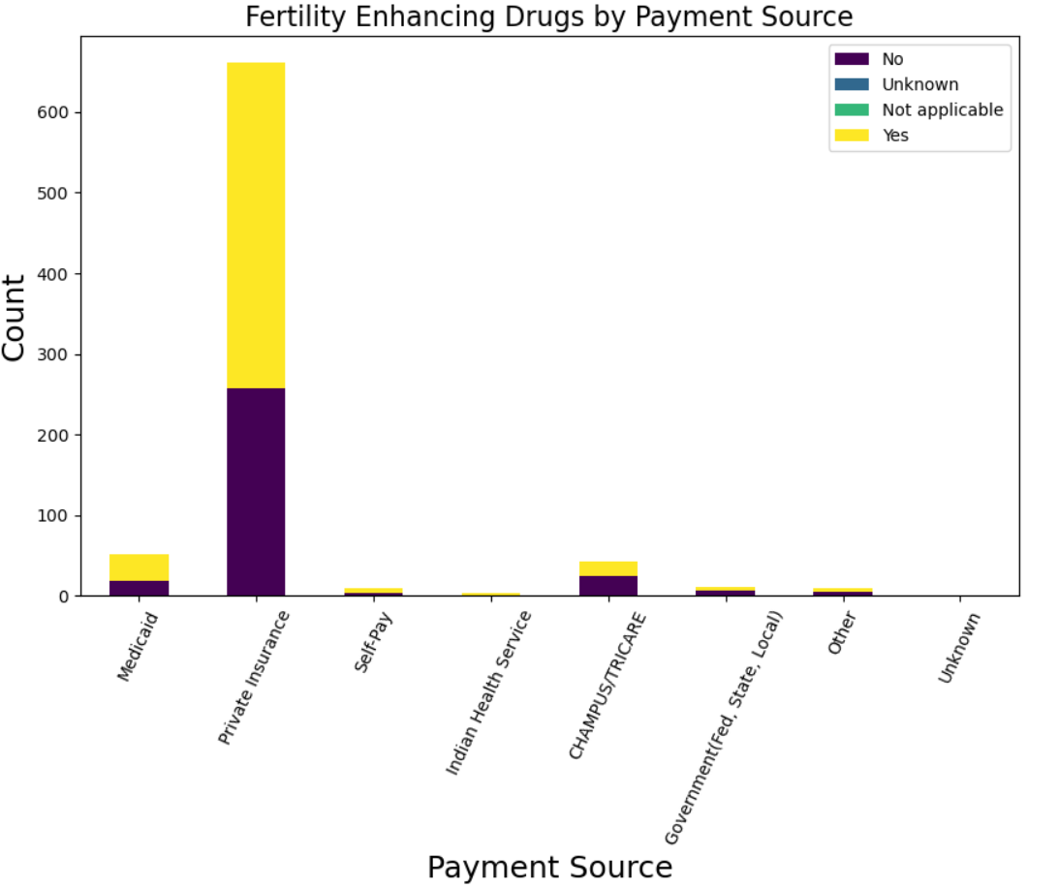
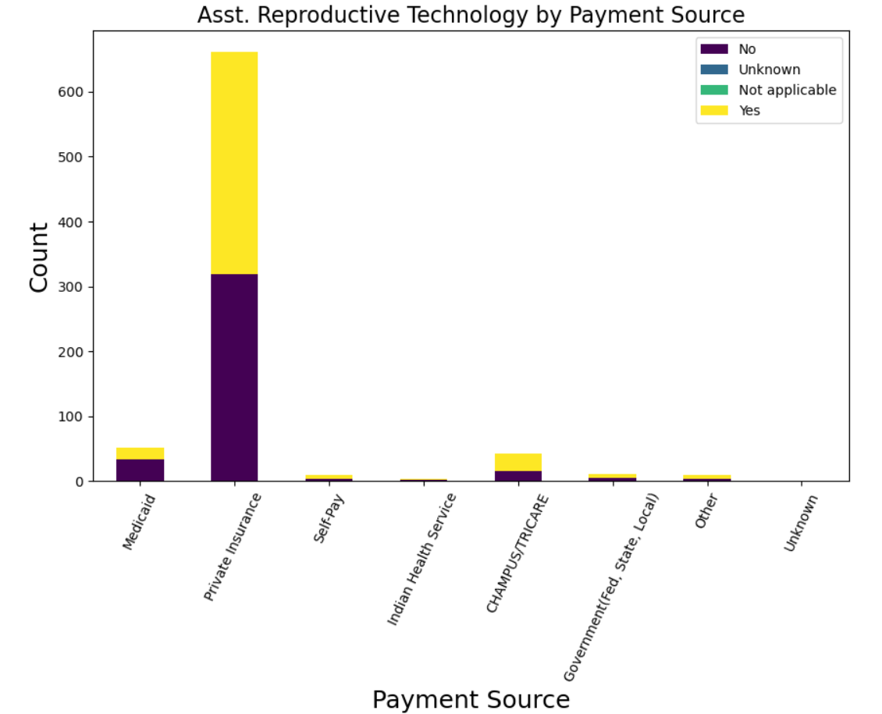
Data Point 8: Infertility Treatment types distribution by Payment Method
Delving deeper into our data, a trend emerges. While exploring Infertility Treatment options, it's intriguing to note that slightly more individuals leaned towards 'Fertility Enhancing Drugs' compared to 'Assisted Reproductive Technology.

Slide 16

Conclusion
Building on our findings, a positive correlation between birth rates and payment sources indicates a potential impact on healthcare outcomes. Notable differences between private and Medicare-insured births suggest significant variances in infant health and maternal resources. As Private Insurance emerges as the primary method for births requiring infertility treatment, this underscores its pivotal role in shaping reproductive healthcare. Future studies should delve into factors like racial inequalities and broader economic connections in the US healthcare landscape.

Slide 17

Sources:
01
Centers for Disease Control and Prevention. (2022). Birth Data Files. Vital Statistics Online. https://www.cdc.gov/nchs/data_access/vitalstatsonline.htm
WHO:
https://www.medicalnewstoday.com/articles/325630#average-weights
Any
Questions?
02

